Slide 1
Social Media Analytics

Slide 2
Agenda
• Importance of web & social media analytics
• Social media analytics with twitter data
• Extracting tweets
• Business analytics use cases with twitter metadata
• Text mining for social media analytics

Slide 3
IMPORTANCE OF WEB & SOCIAL MEDIA ANALYTICS
3

Slide 4






Where do I apply the concepts learnt?
If your potential
customer is out
media
If you want to
cut across the
For a business
that depends
noticed
Course
motivation
4

Slide 5







What happens in the internet every minute…
4,333,560
youtube videos
300 hours of
video uploaded
550 new social
>474,000
Tweets
>38,000 status
updates on
Facebook users
like > 4 million
Over 2,40,000
google search
69,444 million
Instagram posts
6

Slide 6




Where is this data generated from?
Cloud
IoT
7

Slide 7


What is web analytics & social media analytics
Web analytics
Social media analytics
• Measurement and
analysis of data about
• Analysing data from
social media to
web pages
journey, perceptions
& sentiment
8

Slide 8










Applications of WSMA
Shopping cart
analysis
Customer sentiment
analysis
Web page analysis
Hate speech
detection
E-commerce
reviews
Personalised
marketing
9

Slide 9



WSMA and business value
Customer
engagement
• Brand promotion
• Brand salience
Enhance sales
• Targeted promotions on social media
Service
improvement
• Use Voice of customer to improve product/service
Crisis
management
• Sentiment analysis & hate speech detection
Stock indices
• Customer sentiments have an impact on stock indices
10

Slide 10
SOCIAL MEDIA ANALYTICS WITH TWITTER
11

Slide 11




About Twitter..
Social media
platform
Short message
called tweets
Information
from tweets &
Microblogging
site

Slide 12
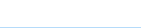


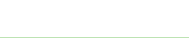
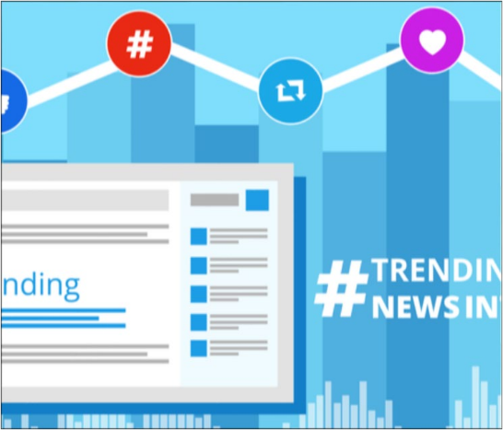



Applications of twitter data
Trending topics
Customer perception
Reach
Event detection
Current
trending topics
• Customer opinion
about a brand
Reach of a
movie, brand or
Detect events
like epidemic or
of a political party,
leader, or event
world

Slide 13









Pros & Cons of twitter data
A very small % of tweets are accurately
geo coded
~1% sample of all the tweets available
limitations of # of tweets extracted for a
free account
length of
tweets is limited
easier to find & follow conversations -
hastag norms
historical search is limited with free
account
Twitter API is more open and accessible
Stores only 6-9 days of tweets
Advantages
Limitations

Slide 14
SETTING UP TWITTER API

Slide 15



What is an API?
Application
programming
Software intermediary
that allows two
each other

Slide 16
Twitter API

Slide 17
Twitter API – R vs Python

Slide 18


Package rtweet
convert response
objects to more user
Rtweet is
an R package
from Twitter API
structures---e.g., data
frames

Slide 19




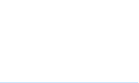
Pre-requisites to setup R
Install the
rtweet and
Open an
interactive
packages in R
Ensure there
is no pop-up
like R studio
Log into your
twitter
your browser
You need a
twitter
your browser

Slide 20







Setting up R environment for Twitter API
use a function like
search_tweets() in
authorize via web
browser popup on
Library(rtweet),
library(httpuv)
One-time setup
session
Twitter account

Slide 21
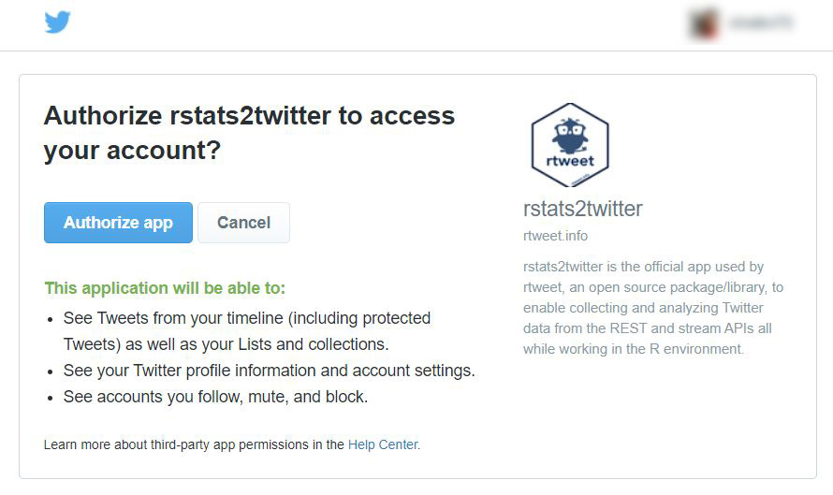

Slide 22
COMPONENTS OF TWITTER METADATA

Slide 23
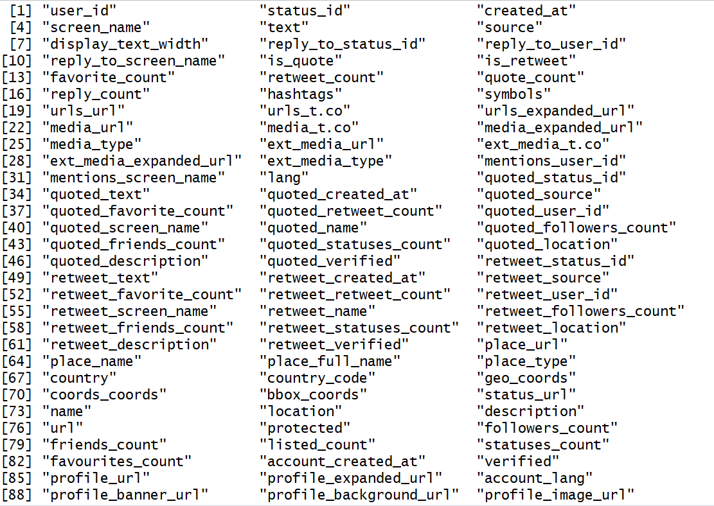
Twitter metadata

Slide 24
Structure of a tweet

Slide 25
USING TWITTER METADATA FOR SOCIAL MEDIA ANALYTICS

Slide 26

EXTRACTING TWEETS USING R

Slide 27

Use case – Targeted promotion
• You are planning to run a twitter ad campaign for an IoT based
product.
these users
for your promotions.
28

Slide 28
Approach for targeted promotion

Slide 29
Followers_count
Follower can read
tweets from accounts
Follower count indicates
popularity of twitter
Digital marketers
strategically position
Measure of influence on
social media
for increased visibility

Slide 30
Use case – Identify popular media for promotions
• You have to run a twitter advt campaign on the twitter pages of 3
news channels.
the maximum visibility
31

Slide 31
Approach to identifying popular media

Slide 32
Retweet_count
utilize existing
content to build a
Tweet re-shared by
another user
brand
The number of
times a tweet is
Can be leveraged by
promoting your
what is trending
popular retweets

Slide 33
Use case – Promote brand around popular retweets
• You are creating branding message for one of your fitness brands
times to bundle your branding message
34

Slide 34
Approach to extracting retweets

Slide 35


Brand salience
Degree to which brand is thought about or
noticed when a customer is in a buying situation
The higher the number of tweets about a brand
over a period of time, greater is its brand salience
36

Slide 36
Use case – compare brand salience
• Compare Netflix and Prime video with time series plots
37

Slide 37
Approach to compare brand salience

Slide 38
TEXT MINING FOR SOCIAL MEDIA ANALYTICS

Slide 39




What is Text Mining?
Examine large
collections of text
to extract
information
relationships or
patterns
Derive actionable
insights
40

Slide 40
Why should we use text for analysis?
41

Slide 41
Core objective of text mining
how to quantify
what a document
How to extract only
the most relevant
42

Slide 42
Challenges in Text Mining
43

Slide 43





What is NLP?
Computer
Science
NLP
Artificical
Intelligence
Human
Language
44

Slide 44













Data Sources for NLP
SM comments,
likes, posts
Google search
Query databases
Blogs
Published doc
Customer review
Website content
45

Slide 45

What will you use NLP for?
Extracting entities
Text classification
Topic extraction
Information retrieval
Relationship extraction
46

Slide 46
USE CASES – TEXT MINING ON TWEET TEXT
47

Slide 47
Use case – extract keywords from tweet text
• Extract keywords on a fitness brand to understand what people
mention frequently about the brand

Slide 48
Approach - Keyword extraction

Slide 49
Use case – sentiment analysis of a brand
• Perform sentiment analysis on a fitness brand to understand
customer’s sentiment on the brand
of a fitness
brand

Slide 50
Approach – sentiment analysis

Slide 51
SOCIAL MEDIA POWERED APPROACH FOR A BUSINESS USE CASE

Slide 52




Customer
•Identify potential customers
•Understand customer interests and
acquisition
•Targeted promotions based on
customer interests
Revenue growth
promotion
Customer
•Understand VoC – Customer
Review Analytics
experience
•NPS scores derived from
Sentiment analysis
Customer loyalty
53

Slide 53







Customer
Choose relevant
social media
Extract user
Identify potential
customers
Identify followers
of the brand
of people
who post on
acquisition
• Fitness brand
Revenue
growth
Customer
experience
Customer
loyalty
54

Slide 54








Customer
Choose relevant
social media
Extract user
names of people
Identify potential
customers
Identify followers
of the brand
acquisition
fitness
• Fitness brand
Revenue
Ta r g e t e d
promotions based
Position your
branding message
Where to promote
– most effective
What to promote -
Extract popular
growth
interests
tweets or trending
topics
Customer
experience
Customer
loyalty
55

Slide 55








Customer
Choose relevant
social media
Extract user
names of people
Identify potential
customers
Identify followers
of the brand
acquisition
fitness
• Fitness brand
Revenue
Ta r g e t e d
promotions based
Position your
branding message
What is trending in
the world of
Extract popular
tweets on fitness
growth
interests
tweets or trending
topics
Customer
Understand
Voice of
Extract
keywords from
Understand
customer
experience
Topic modeling
posts
Customer
loyalty
56

Slide 56



Customer
Choose relevant
social media
Extract user
names of people
Identify potential
customers
Identify followers
of the brand
acquisition
fitness
• Fitness brand
Revenue
Ta r g e t e d
promotions based
Position your
branding message
What is trending in
the world of
Extract popular
tweets on fitness
growth
interests
tweets or trending
topics
Customer
Understand
Voice of
Extract
keywords from
Understand
customer
experience
Topic modeling
posts
Customer
Identify promoters
& detractors based
Customer
sentiment & NPS
Perform sentiment
analysis on brand
Review trackers to
quickly flag
loyalty
scores
57

